Slide 1
Welcome to Mrs. Morrissey’s Kindergarten Class!!

Slide 2
Dear Parents,
Welcome back to a new school year! My name is Mrs. Melissa Morrissey and I will be your child’s teacher this year. I am so happy to welcome you to our classroom! Kindergarten is a very busy year filled with lots of fun and exciting learning opportunities. I am very excited about what is in store for your child this year, and I look forward to working with you as well.
This is my 5th year at BRCVPA and my 3rd year teaching Kindergarten. I have previously taught 1st and 2nd grades. My daughters, Maeve(4th) and Fallon (2nd), are also students at BRCVPA. When I am not teaching, I enjoy traveling with my husband and children, yoga, reading, swimming, and running. I coach Girls on the Run afterschool on Tuesdays and Thursdays and an EBR Teacher Leader.
I am looking forward to a fun-filled year with your child. I have so many exciting things planned and can’t wait to get started!
Sincerely,
Mrs. Morrissey

Slide 3
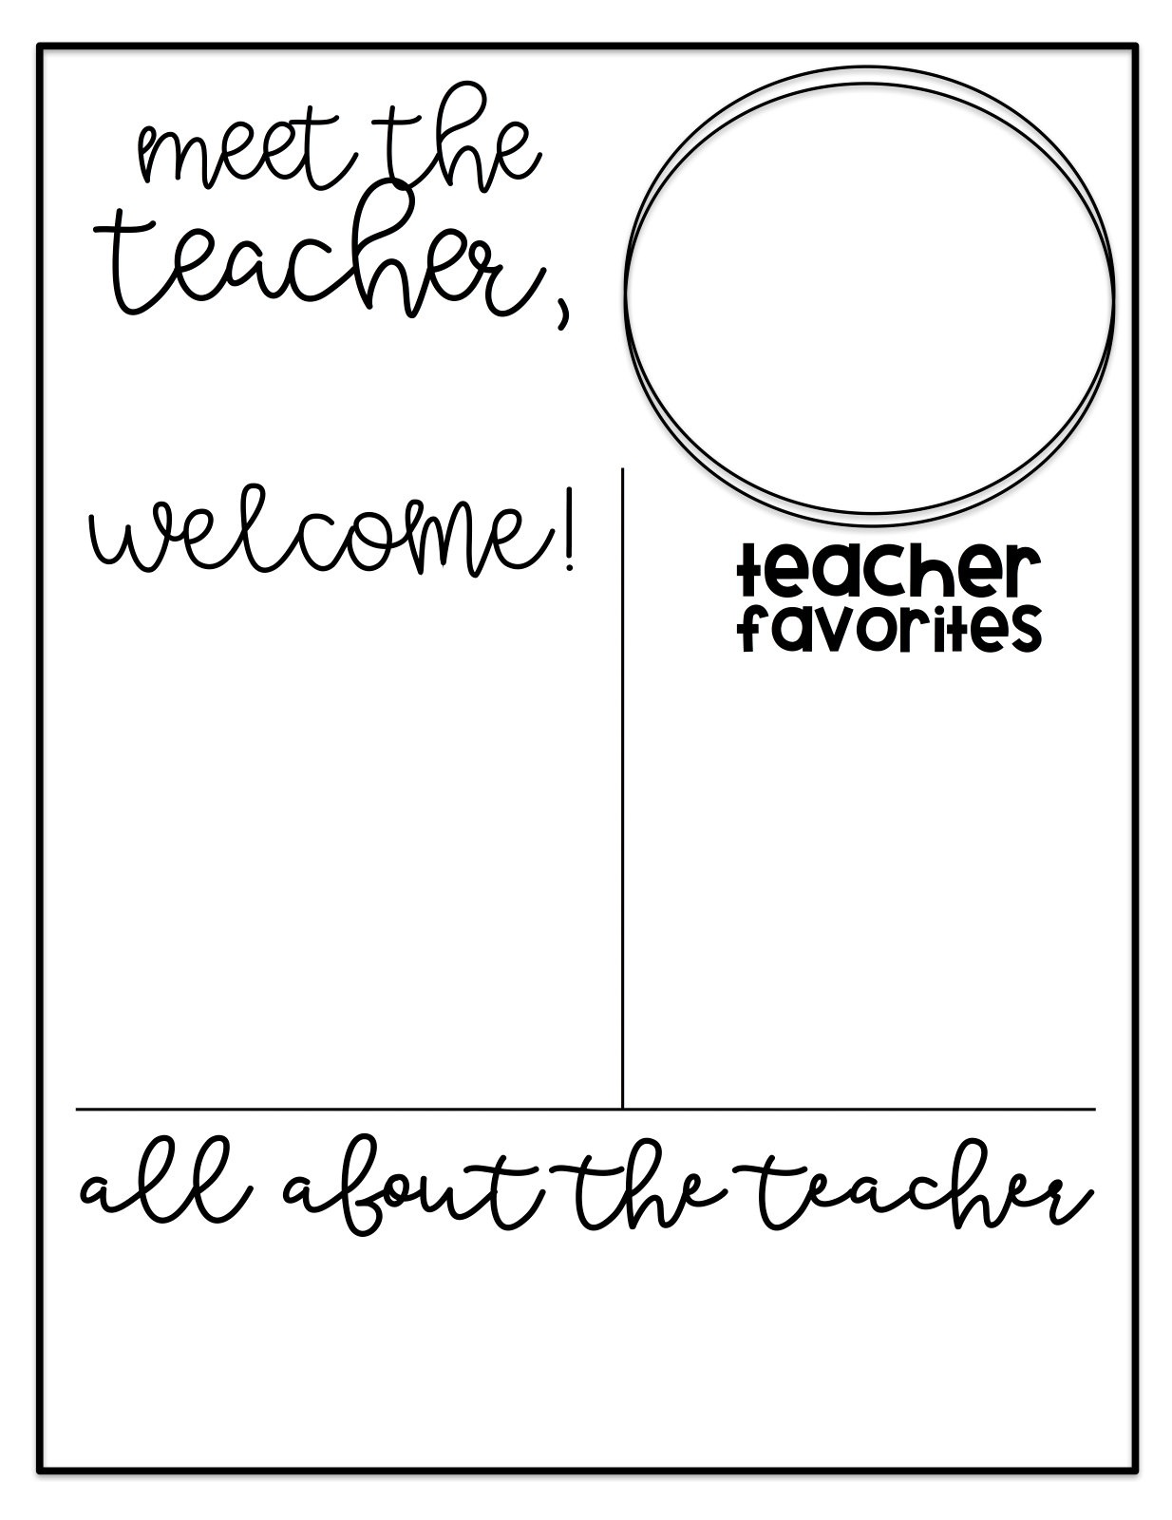
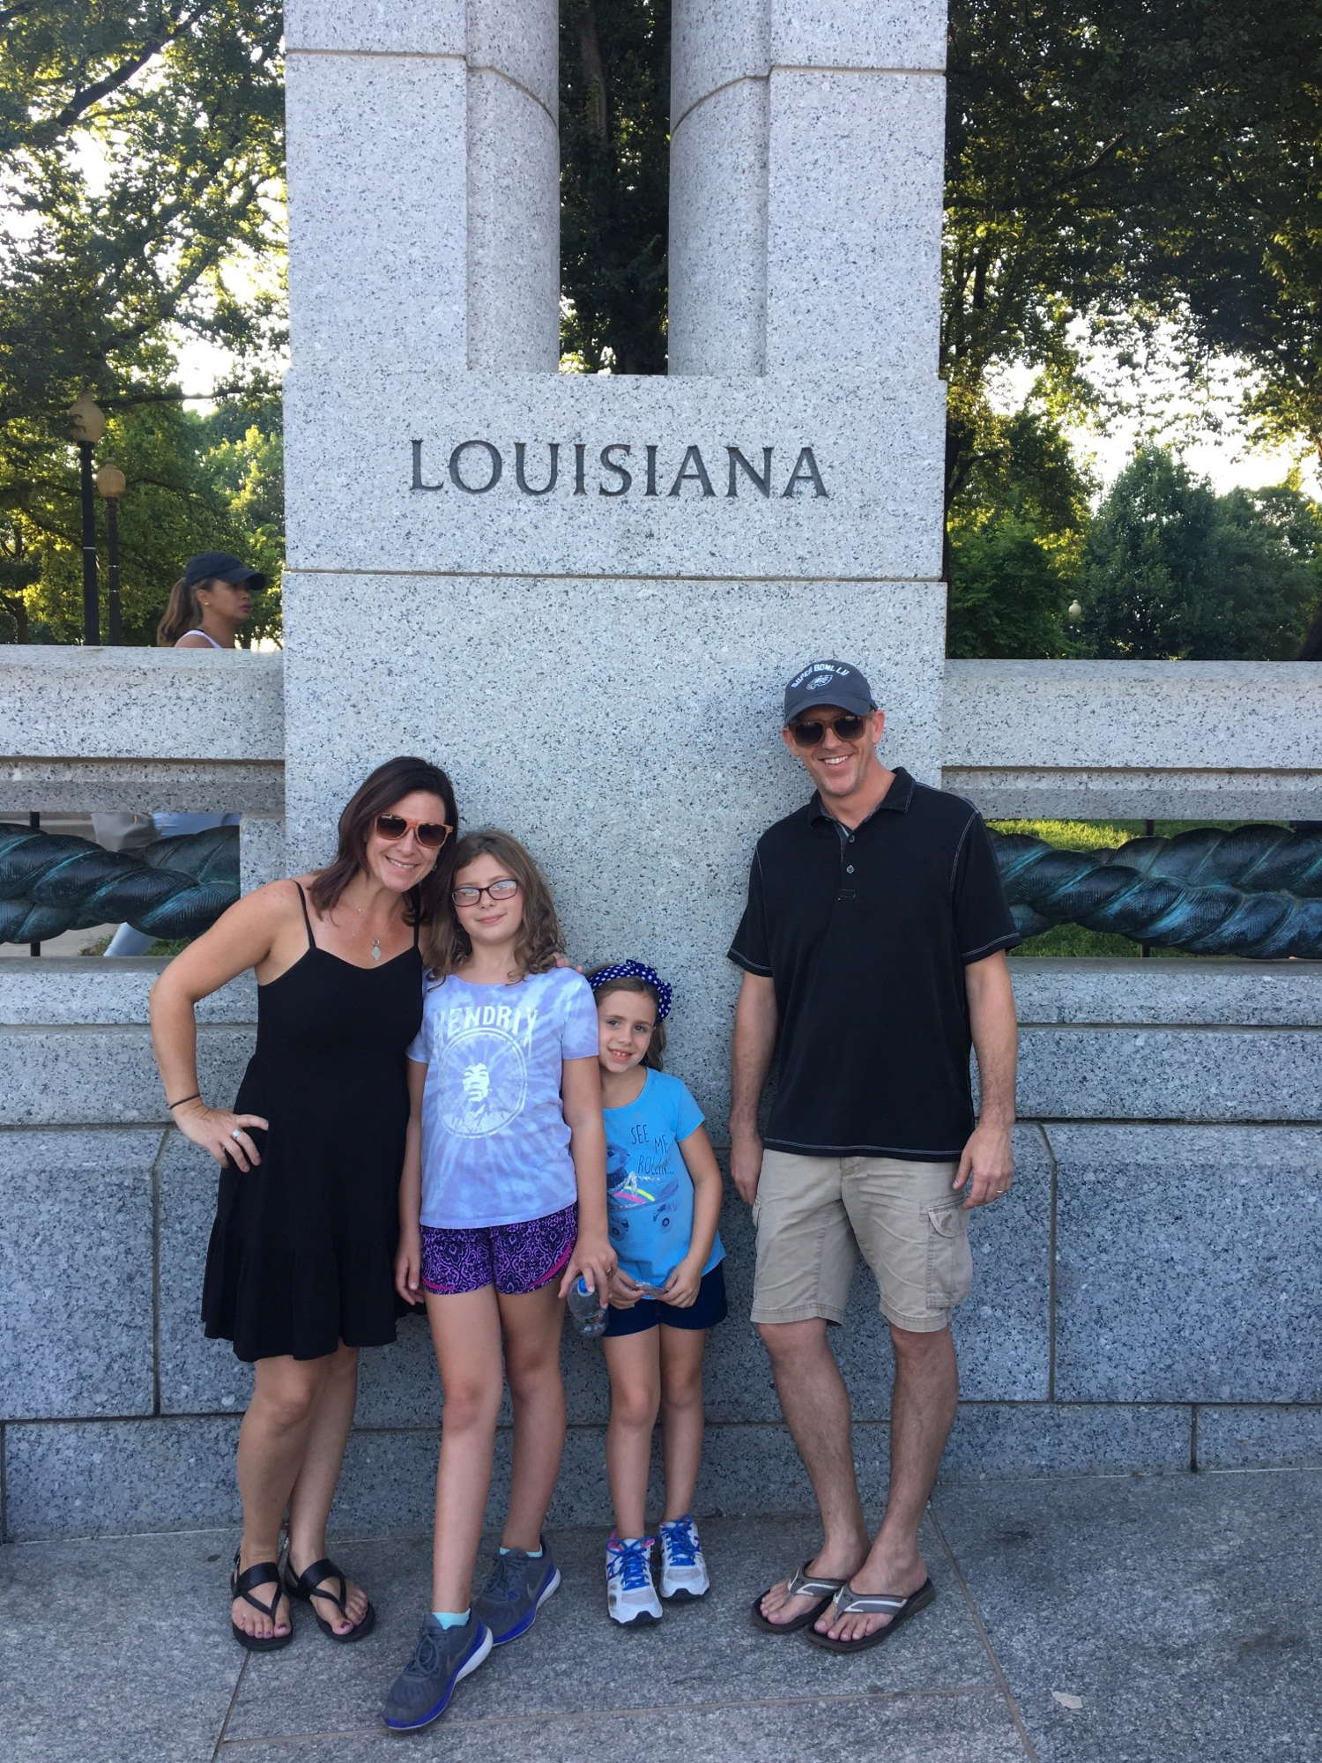
BRCVPA
Mrs. Morrissey
Drink: Iced Chai
Color: Purple
Candy: Swedish Fish
Hobbies: Traveling, sewing, crafting, yoga, reading
Place to shop: Amazon & Trader Joes
Fast Food: Southfin & Jimmy Johns
Scent: Lavender
This is my 5th year at BRCVPA and my 3rd year teaching Kindergarten. I have previously taught 1st and 2nd grades. My daughters, Maeve(4th) and Fallon (2nd), are also students at BRCVPA. When I am not teaching, I enjoy traveling with my husband and children, yoga, reading, swimming, and running. I coach Girls on the Run afterschool on Tuesdays and Thursdays and an EBR Teacher Leader.

Slide 4
ATTENDANCE
The school day begins at 8:00am and is dismissed at 3:15pm. Your child is expected to arrive no later than 8:25am, or they will be considered tardy (aside from buses arriving late). We have a very busy day if learning and it is very important that your child arrives on time and does not check out early unless it is necessary. Please let me know in advance, if possible, when your child will be absent, arriving late, or checking out early. Please be sure to read the district attendance policy.
CLASS WEBSITE
We have a classroom website! Be sure to check it out at www.morrissey1819.weebly.com! Here you will find newsletters, photos, important dates, online resources, and much more! I do my best to keep it updated as often as possible. If you do not wish to have your child’s picture posted on the class website, please let me know.
NEWSLETTER
A newsletter will be sent home on Mondays, with the weekly skills that will be taught during the week, as well as important information about what’s happening at school. The newsletter will also be posted weekly on the website.
HOMEWORK
A homework packet will be sent home each week, on Mondays. Additional homework may be sent home throughout the week to help your child with reading and math skills. Homework is meant to be used as EXTRA PRACTICE at home and will not be taken for a grade.

Slide 5
BIRTHDAY CELEBRATIONS
Students are more than welcome to bring a treat on their birthday to share with the class, Please message me a day prior to bringing the treats. All birthday treats will be served during recess (12:50-1:10). Be sure to provide paper products (plates, napkins, utensils, cups).
VOLUNTEER OPPORTUNITIES
I am always looking for extra “helpers” to assist with center/lesson prep (cutting, laminating, making copies), classroom activities, and organization (reading folders, class library). Please let me know if you would like to help. There are also many opportunities for you to help at school throughout the year. Are you an “expert”? You can also volunteer to share your expertise with the students, too!!
WHAT TO BRING TO SCHOOL
BOOKSACK Please be sure to put your child’s name on their booksack.
CHANGE OF CLOTHES: Please bring a FULL change of clothes to school ASAP in a labeled GALLON sized Ziploc bag. You may be called to bring your child a change of clothes if they become soiled, so please be sure to bring in a spare, just in case!! Be sure to include uniform tops and bottoms that are seasonally appropriate, underwear and socks.
LUNCH- Please be mindful to pack a healthy lunch to fuel your child’s busy brain, if they are bringing lunch from home. Please be sure that your child’s food and containers are items that they can use INDEPENDENTLY. I can not heat up food and we do not store lunches in refrigerators, so be sure to pack an ice pack to keep food cool.
SNACKS: If you wish for your child to have a healthy snack at recess, please provide a snack for your child. The class does not provide snacks, unless there is a special occasion.
SCHOOL SUPPLIES: If you already ordered your supply kit, thank you! If you did not, please provide supplies for your child as soon as possible.

Slide 7
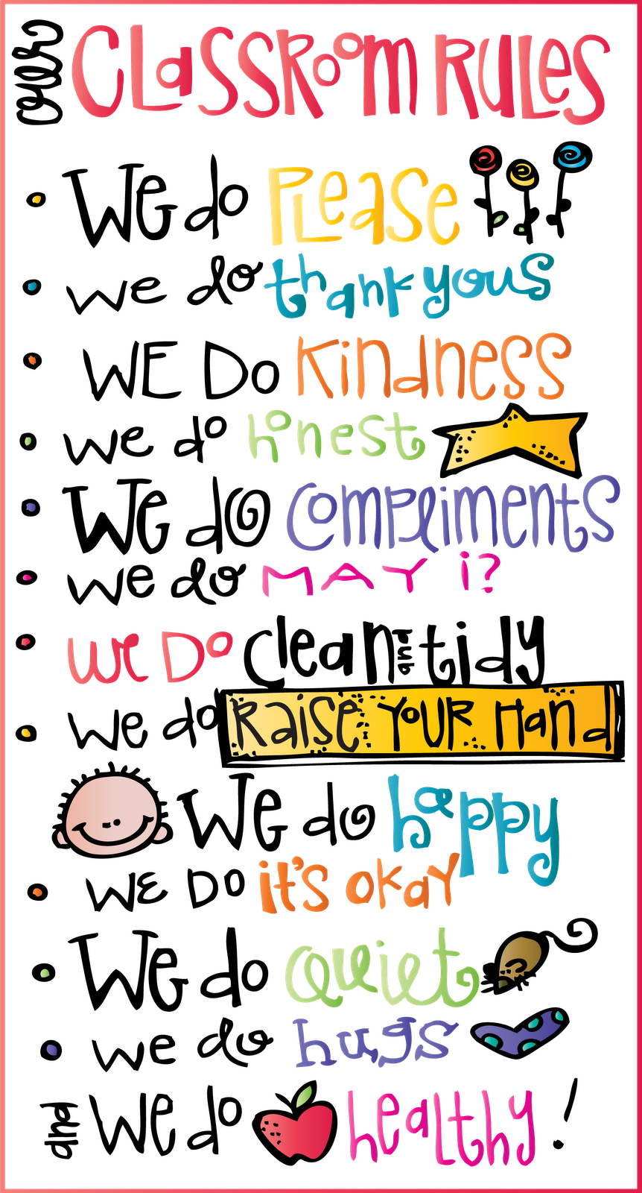

Slide 8
This year we will be using a web-based program called Class Dojo as a communication tool to help keep you updated about your child’s behavior, academics, and the happenings of the classroom!
Class Dojo will be used mostly as a communicative tool for us as a team to discuss behavior in the classroom and at home and how it impacts your child’s learning. You will also learn of events at school and in the classroom through Dojo.
Your invitation letter from Class Dojo with directions on how to connect to our class is included in your Parent Packet. Please do so as soon as possible! Once you have joined our class, you will be able to check your child’s progress at anytime of the day. Another great feature of Class Dojo is the ability for me to send messages to parents. It is a great communication tool and is a great way for you to stay informed on your child’s progress.
Please let me know if you have any questions. I am looking forward to using this great resource to communicate with you.
ABOUT CLASS DOJO

Slide 9
Before you Go…
SIGN IN on the clipboard by to door.
TAKE A PICTURE with your child and be sure to write your names on the dry erase board before you take your pic. Send the picture to me in the CLASS DOJO APP.
Take your child’s work packet with you and return the papers in the work packet. I will use the work packet throughout the year to send home your child’s work. Work packets should be signed, and returned (with the papers included) ASAP.
YOU HAVE HOMEWORK!!! Please use the blank white cardstock paper in the work packet to make a scrapbook page of your child and family. Please keep all pictures and items 2-dimentional and keep items on the page. They will be put into page protectors and used as a class family album for us to get to know your child and your family.
********DID YOU INDICATE HOW YOUR CHILD WILL BE DISMISSED FROM SCHOOL??*********** PLEASE SEE THE FORM NEXT TO THE SIGN IN SHEET. PLEASE BE SURE TO INDICATE IF YOUR CHILD WILL BE DISMISSED DIFFERENTLY AFTER THE FIRST DAY OF SCHOOL.
Any other questions or concerns that you have about your child starting school can be addressed by contacting me through the CLASS DOJO App or email.
I AM SO EXCITED TO WORK WITH YOU AS A PARTNER IN YOUR CHILD’S EDUCATION AND TO GET TO KNOW YOUR CHILD! WE ARE GOING TO HAVE A GREAT YEAR!!!

